Slide 1
Monitoring and assessing ‘performance’
=

Slide 2


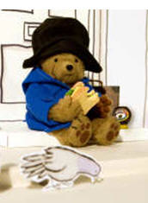
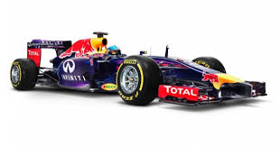
How has
Henry been performing?
You just don’t know how good you are!

Slide 5
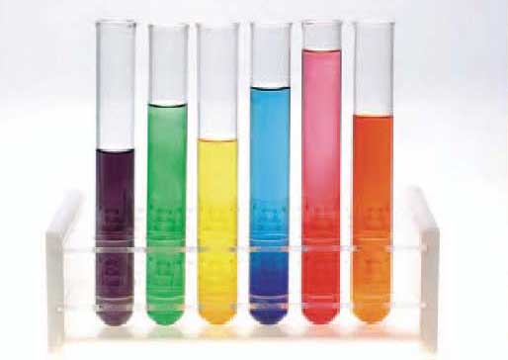
Core knowledge
& skills
English
Maths
Science
French....
CURRICULUM
How to learn
How to think
How to work with others
Self-care and well-being

Slide 6
What is the purpose of school?

Slide 7
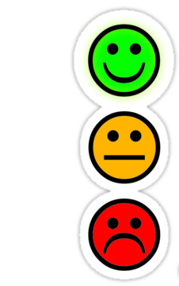


The purpose of school
(Some historical assumptions)
A
*
unintended consequences
Notes:
The most effective way to bring about success for a society and its economy is to develop the academic intelligence of its younger generation

Slide 8
3Rs
Reading Remembering Regurgitating

Slide 9
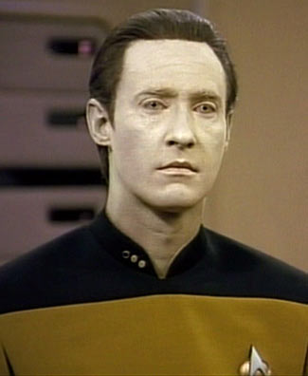

Slide 10
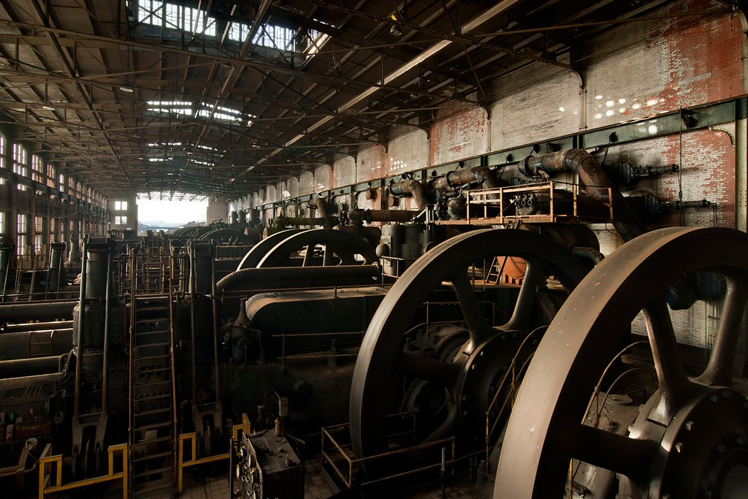
performance

Slide 11
3 x 7 = 21
successful learner?

Slide 12
Growth mindset
Fixed mindset

Slide 13

Good to
be right
Bad to
be wrong

Slide 14


Good to
succeed
Bad to
fail

Slide 15
performance = results
=

Slide 16

Academic progress
Progress
Progress
Progress

Slide 18
‘Not everything that counts can be counted.’
Have you tried?

Slide 20
A

Slide 21
125

Slide 22
82%

Slide 23
82%

Slide 24
82%
ATTITUDES

Slide 25
82%
ATTITUDES
BEHAVIOURS

Slide 26
HIDDEN LEARNING
82%
ATTITUDES
BEHAVIOURS
SKILLS

Slide 27
82%
RESULTS

Slide 28
The purpose of a school is to help its students to make
PROGRESS.
Grades

Slide 29
The purpose of a school is to help its students to make
PROGRESS.
Grades

Slide 30
The purpose of a school is to help its students to make
PROGRESS.
Grades

Slide 31
KNOWLEDGE
AND
UNDERSTANDING

Slide 32
ATTITUDES
BEHAVIOURS
KNOWLEDGE
AND
UNDERSTANDING
SKILLS

Slide 33
ORK
CORE KNOWLEDGE
Academic results

Slide 34
WORK
CORE KNOWLEDGE
Academic results
ATTITUDES
BEHAVIOURS
SKILLS
HOME

Slide 35
The Hidden Curriculum

Slide 36
HIDDEN LEARNING

Slide 37
HIDDEN LEARNING
Learning performance

Slide 38
HIDDEN LEARNING
Learning performance
Observing

Slide 39
HIDDEN LEARNING
Learning performance
Observing
Tracking

Slide 40
HIDDEN LEARNING
Learning performance
Observing
Tracking
Reporting

Slide 41
HIDDEN LEARNING
Learning performance
Observing
Tracking
Reporting
Modelling

Slide 42
1. Learning performance
HIDDEN LEARNING
ACADEMIC RESULTS ARE IMPORTANT!

Slide 43

1. Learning performance
HIDDEN LEARNING
PERFORMANCE
RESULTS
$$≠$$
INPUT
OUTPUT

Slide 44
LEARNING PERFORMANCE
ATTITUDES
BEHAVIOURS
SKILLS
CURIOSITY
ADAPTABILITY
CREATIVITY
OPTIMISM
SELF-MOTIVATION
SELF-MANAGEMENT
PRIDE
PERSEVERANCE
CRITICAL THINKING
TRUST
COOPERATION
COMMUNICATION
www.hiddenlearning.co.uk
Andrew Hammond
Hidden Learning Ltd.

Slide 45
HIDDEN LEARNING
Learning performance

Slide 46
HIDDEN LEARNING
Learning performance
Observing

Slide 47
What does effective learning look like in the classroom?
How can we observe learning performance in action?

Slide 48
2. Observing learning performance
‘Key observables’
actions and behaviours
insightful comments made
good learning routines
level of involvement

Slide 50
HIDDEN LEARNING
Learning performance
Observing

Slide 51
HIDDEN LEARNING
Learning performance
Observing
Tracking

Slide 52
3. Tracking learning performance

Slide 53

3. Tracking learning performance
Beginning +
48%
Expected progress
115 VR
B+
GLD
RAG
Grade 7
Working towards
Floor standard

Slide 54
Half-termly grades
Effort and attainment

Slide 55
Half-termly grades
Effort and attainment

Slide 56
What are we measuring?
And how?

Slide 57
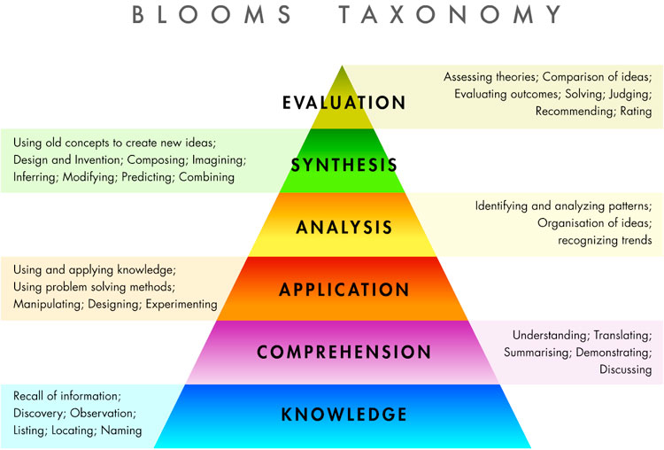
doing
thinking
discovering
applying
communicating

Slide 58
Ladder of engagement
CURIOSITY
1
REFLECTION
2
COMPLIANCE
3
PASSIVITY
4
DEFIANCE
5

Slide 59
THE LEUVEN SCALE FOR WELL-BEING
Level | Well-being | Signals
1 | Extremely low | The child clearly shows signs of discomfort such as crying or screaming. They may look dejected, sad, frightened or angry. The child does not respond to the environment avoids contact and is withdrawn. The child may behave aggressively, hurting him/herself or others.
2 | Low | The posture, facial expression and actions indicate that the child does not feel at ease. However, the signals are less explicit than under level 1 or the sense of discomfort is not expressed the whole time.
3 | Moderate | The child has a neutral posture. Facial expression and posture show little or no emotion. There are no signs indicating sadness or pleasure, comfort or discomfort.
4 | High | The child shows obvious signs of satisfaction (as listed under level 5). However, these signals are not constantly present with the same intensity.
5 | Extremely High | The child looks happy and cheerful, smiles, cries out wit pleasure. They may be lively and full of energy. Actions can be spontaneous and expressive. The child may talk to him/herself, play with sounds, hum or sing. The child appears relaxed and does not show any signs of stress or tension. He/she is open and accessible to the environment. The child expresses self-confidence and self-assurance.

Slide 60
THE LEUVEN SCALE FOR INVOLVEMENT
Level | Involvement | Signals
1 | Extremely Low | Activity is simple, repetitive and passive. The child seems absent and displays no energy. They may stare into space or look around to see what others are doing.
2 | Low | Frequently interrupted activity. The child will be engaged in the activity for some of the time they are observed, but there will be moments of non-activity when they will stare into space, or be distracted by what is going on around them.
3 | Moderate | Mainly continuous activity. The child is bust with the activity but at a fairly routine level and there are few signs of real involvement. They make some progress with what they are doing but don’t show much energy and concentration and can be easily distracted.
4 | High | Continuous activity with intense moments. The child’s activity has intense moments and at all times they seem involved. They are not easily distracted.
5 | Extremely High | The child shows continuous and intense activity revealing the greatest involvement. They are concentrated, creative, energetic and persistent throughout nearly all the observed period.

Slide 63
Red
Amber
Green

Slide 64
Bronze
Silver
Gold

Slide 65
HIDDEN LEARNING
Learning performance
Observing
Tracking

Slide 66
HIDDEN LEARNING
Learning performance
Observing
Tracking
Reporting

Slide 67
4. Reporting on learning performance
L A N G U A G E

Slide 68
A new language for hidden learning
Old paradigm
New paradigm
progress
assessment
results
performance

Slide 69
A new language for hidden learning
Old paradigm
New paradigm
progress
development
assessment
observation
results
evidence
performance
behaviours, attitudes and skills

Slide 70
The Form Tutor’s report
4. Reporting on learning performance

Slide 71
4. Reporting on learning performance

Slide 72
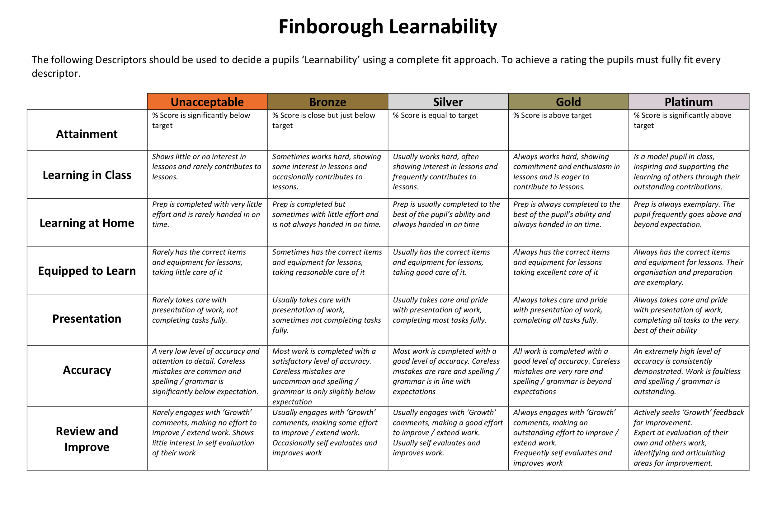

Slide 73
Habits of mind
Learner profile
Performance profile
Learning habits

Slide 74
Dual learning
Learning core knowledge
and
Learning how to learn

Slide 75
HIDDEN LEARNING
Learning performance
Observing
Tracking
Reporting

Slide 76
HIDDEN LEARNING
Learning performance
Observing
Tracking
Reporting
Modelling

Slide 77
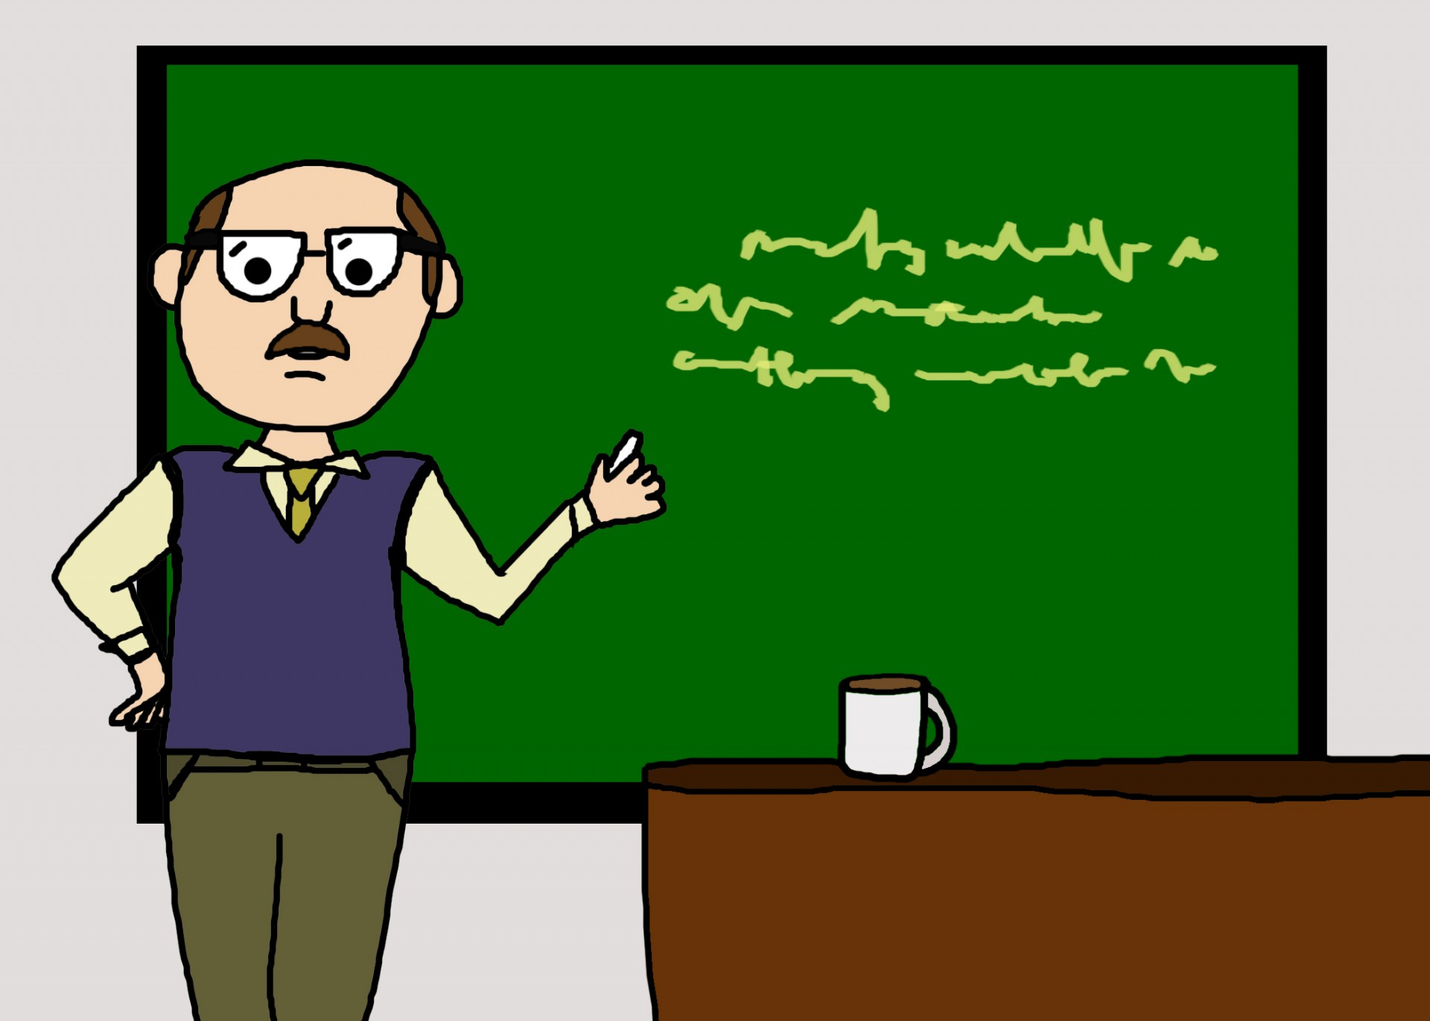
It’s about us

Slide 78
Model learners

Slide 79
Attitudes, behaviours and skills
we model

Slide 80
Modelling the hidden things
Optimism is a choice
Self-control is achievable
Resilience can be demonstrated
Adaptability – managing change
Cooperation – it’s how a school works

Slide 81
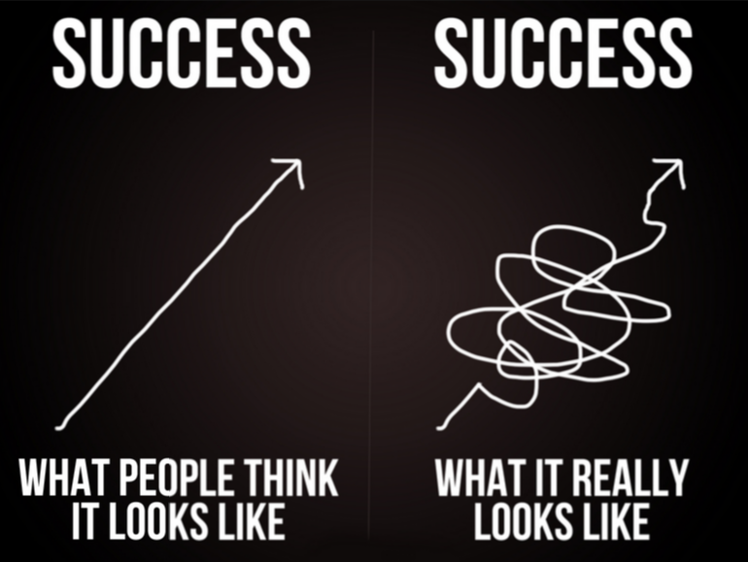
9997
PROGRESS
PROGRESS

Slide 82
9997

Slide 83
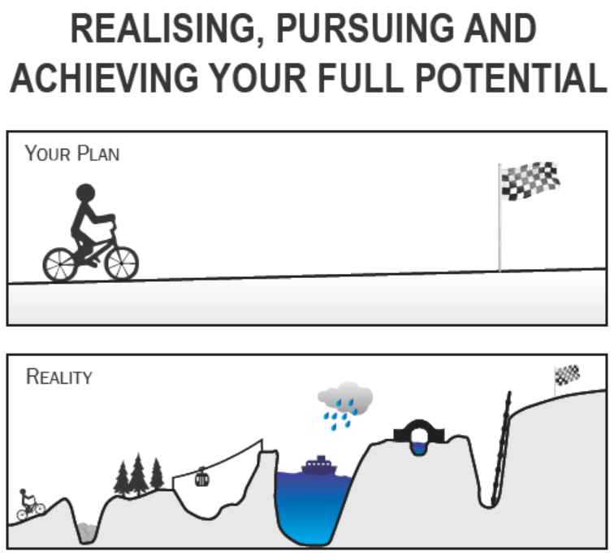
ATTITUDES
BEHAVIOURS
SKILLS

Slide 84
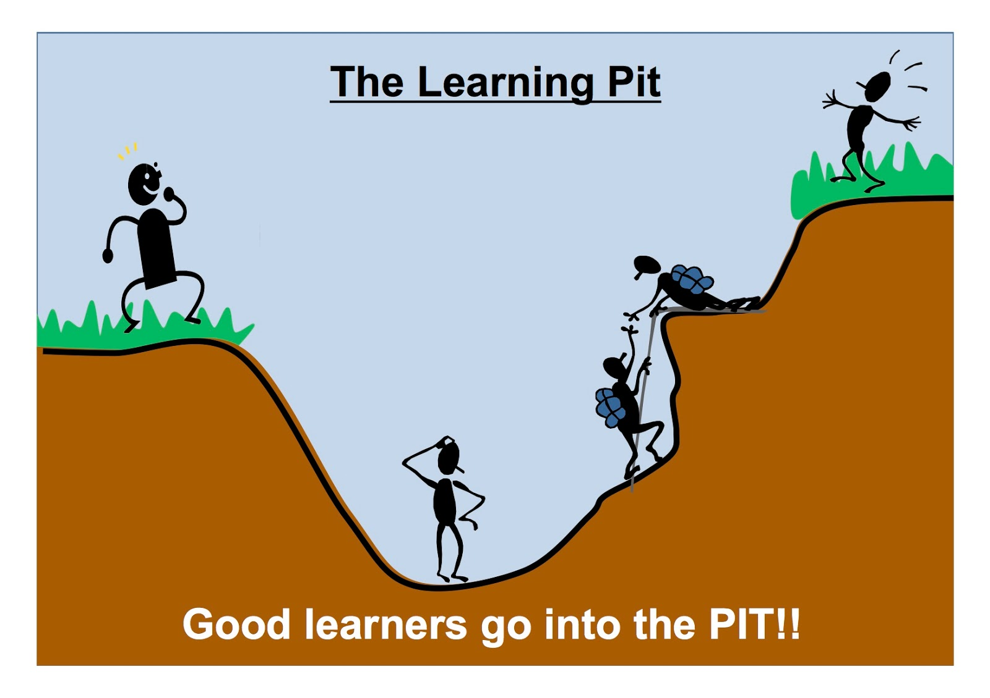

Slide 85
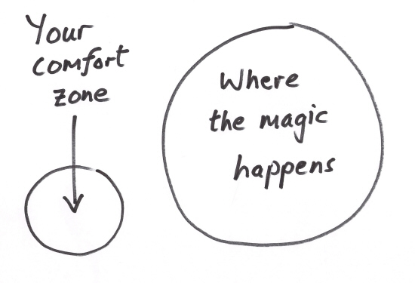


OFF-ROAD LEARNING

Slide 86
How we feel is what’s real; it’s the link to what we think.
Eric Jensen

Slide 87
My teacher thought I was cleverer than I was. So I was.
A six year old

