Slide 1
Managing Difficult Conversations Thomas Packer
Solutions for Schools

Slide 3
Your core values
Let’s take a look at your core values ….

Slide 4
Your priorities?
to performance manage the staff |  | ensure that all staff adhere to whole school policies and procedures
keep the staff happy |  | balance the budget
deploy staff effectively to deliver the best outcomes for pupils |  | keep the parents happy
introduce new teaching strategies regularly |  | ensure that pupils are inspired to love learning for its own sake in every lesson

Slide 5
Which ones might lead to a difficult conversation?
to performance manage the staff |  | ensure that all staff adhere to whole school policies and procedures
keep the staff happy |  | balance the budget
deploy staff effectively to deliver the best outcomes for pupils |  | keep the parents happy
introduce new teaching strategies regularly |  | ensure that pupils are inspired to love learning for its own sake in every lesson

Slide 6
The 3 stages
Prevention - How your school can reduce the number of difficult encounters
Managing – How you manage difficult people and those resistant to change
Conversations – How to run a potentially difficult meeting
Conclusions

Slide 7
Dealing with workplace conflict or managing difficult people is a process not an event

Slide 8
Prevention
Difficult people impede action
Some
Were born to be difficult
Like to cause trouble
Have a legacy from the past
Have a different agenda from you
Don’t appreciate your approach
It’s rarely personal (except jealousy)

Slide 9
Prevention
Let’s describe your “Difficult Person” ….

Slide 10
Prevention
They just don’t see things like me’
People search for the evidence to support their beliefs (Kruger & Dunning)

Slide 11
Prevention
??% of people claim to have above average leadership skills
??% of people rate themselves in the top 10% for ‘getting on with people’.
??% of people think they are in the top 1%
An overwhelming majority claim to be less susceptible than the average person
Doctors were ??% confident in their diagnosis but ??% were accurate
??% of university lecturers thought they were better at their jobs than their colleagues

Slide 12
Prevention
70% of people claim to have above average leadership skills
60% of people rate themselves in the top 10% for ‘getting on with people’.
25% of people think they are in the top 1%
An overwhelming majority claim to be less susceptible than the average person
Doctors were 88% confident in their diagnosis but 20% were accurate
94% of university lecturers thought they were better at their jobs than their colleagues

Slide 13
Prevention
The basics that lead to conflict …

Slide 14
4 workplace basics that can cause conflict
GOALS
ROLES
What we are here to achieve as a team
Who does what in the team
How we interact
How we carry out the job
How do these impact on each other?
RELATIONSHIPS
PROCESSES

Slide 15
Prevention
Communication …
How email, face to face, meeting …
When putting people in the right order
With whom not leaving people out (or including the wrong ones)

Slide 16
Managing
Fear of change
Different people are different

Slide 17
Different people
Are different!
A social style is a “pervasive and enduring pattern of interpersonal behaviours” (Bolton & Bolton, 1984).
Notes:
A social style is a “pervasive and enduring pattern of interpersonal behaviours” (Bolton & Bolton, 1984, p. 3). It is not the beliefs and values parts of your personality but the part that can be observed by others – it is what you say and do.

Slide 18
The Social Styles Model is based on two dimensions of interactive behaviour…
Source: Darling, J. and Walker, W. 2001. Effective conflict management: Use of the behavioural style model.

Slide 19
respons iveness
assert iveness
Source: Darling, J. and Walker, W. 2001. Effective conflict management: Use of the behavioural style model.

Slide 20
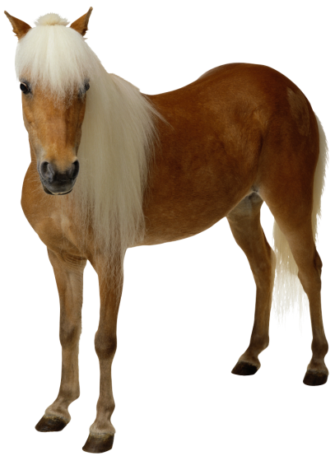
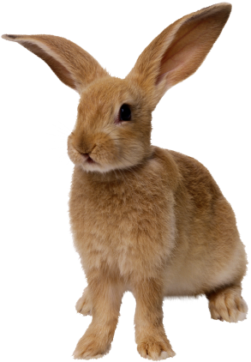
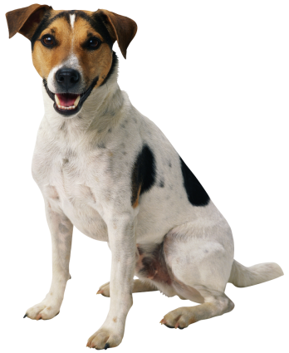
…resulting in 4 social types
Analyser (Process-oriented)
Strengths: Logical, dilligent, critical, systematic, prudent, serious.
Weaknesses: Demanding, tough, inflexible.
Driver (Action-oriented)
Strengths: Independent, forthright, efficient, pragmatic, determined, decisive.
Weaknesses: Controling, dominating, insensitive.
Amiable (People-oriented)
Strengths: Cooperative, loyal, supportive, diplomatic, easy-going, respectful, friendly.
Weaknesses: Conforming, permissive.
Expressive (Idea-oriented)
Strengths: Imaginative, outoing, enthusiastic, excitable, spontaneous, persuasive.
Weaknesses: Undisciplined, unrealistic, disruptive.
Source: Darling, J. and Walker, W. 2001. Effective conflict management: Use of the behavioural style model.

Slide 21
Activity: Your Social Type
Try the quick self-Assessment

Slide 22
4 social types
What’s your main Type?
What about some of your key team members?
Source: Darling, J. and Walker, W. 2001. Effective conflict management: Use of the behavioural style model.

Slide 23
Caveat …
☺ Creates a good understanding of individual behaviour, useful in many situations | ☹ It might cause rank issues of one style feeling superior over the other
☺ It is concrete and measurable, as it is based on observed behaviour | ☹ Choosing wrong evaluators influences the outcome
☺ Helps to increase team performance | ☹ Can give a false sense of understanding human behaviour
☺ The styles are practical and easy to apply in everyday life | ☹ The tool we used has limited accuracy
but we like it!
Notes:
For the scoring of our group, we used an excel based test that has been used by a well known consultancy firm.
Why do we like it?
Understanding behaviour in many situations
Measurable
Team performance
Practical once you know it
Why don’t we like it?
Rank issues (Drivers are better than amiables)
Influence of evaluator
Pop psychology
Accuracy?
Conclusion: every MBA should…. (next slide)

Slide 24
Analyser Talks about: Facts and figures; policies and systems; planning and forecasting; analysis and control. Driver Talks about: Results, getting things done, performance, efficiency, productivity and achievements. Amiable Talks about: Needs, emotions, beliefs; motivations and values; teamwork; team spirit; relationships. Expressive Talks about: Innovation, new ways of doing things, creativity, alternatives, grand designs and change.

Slide 25
THE INTERACTION OF STYLES
Style flexing is the ability to adjust your style to meet that of your colleague/customer. Consider how you are alike and/or different when collaborating in any joint effort.
Styles Shared Dimension Conflict Agreement
Analytical vs. Amiable Low Assertiveness Priorities Pace
Driver vs. Expressive High Assertiveness Priorities Pace
Analytical vs. Driver Low Responsiveness Pace Priorities
Amiable vs. Expressive High Responsiveness Pace Priorities
Analytical vs. Expressive None Both None
Amiable vs. Driver None Both None

Slide 26
Persuading …
Analysers | Expressives
Be careful with your facts Work out the details in advance Reduce risk factors Be systematic Use concrete/practical examples | Present a global picture Give them interesting ideas Show possibilities for the future Indicate where challenges lie Be confident and enthusiastic/up beat
Drivers | Amiables
Be logical Indicate costs and benefits/pros and cons Stress the need for competence Draw clear conclusions | Be sensitive and friendly Explain the value and importance Show concern for people Listen and show appreciation

Slide 27
Managing
The main reason why people are difficult or resistant to change …
FEAR

Slide 28
Managing
Whether difficult people act passively or aggressively, or swing
between both, they are no doubt motivated by fear. They’re
insecure and lack confidence. They worry about having enough
attention, recognition, and control.
Fear is a root that holds difficult people fast in their world. Their fear
may cause them to be needy, self-indulgent, and unaware of what
is going on around them. They may resist change, or insist on
being right, knowledgeable, and victorious all the time. They see
themselves as victims and spend a lot of energy looking for
evidence to support their view.

Slide 29
Managing
Why change fails ….
People – inertia; disengagement; fear; lack of skills; work load (or perceived work load). Remember – success breeds comfort
Communication (either lack of, or inappropriate or poorly timed)
Vision too complicated or too vague
Plan not fit for purpose

Slide 30
Managing
"It is not the strongest of the species that survives, nor the most intelligent, but the one most responsive to change"
Charles Darwin

Slide 31
Conversations
WHAT OFTEN HAPPENS …

Slide 32
Conversations
Avoid the conflict
Deny the conflict; wait until it goes away
Change the subject
React emotionally: Become aggressive, abusive, hysterical, or frightening
Find someone to blame
Make excuses
Let someone else deal with it

Slide 33
Conversations
Don’t avoid a difficult meeting
Do it NOW
Your pupils deserve it!

Slide 34
Conversations
Language
Assertiveness
Planning

Slide 35
Conversations
Body Language
Bridge Language
Barrier Language
Listening

Slide 36
Conversations
“You’re not going to like this…”
Stop interrupting me!”
This is calculated to cause fear and uncertainty. AVOID!
“Can you hold on a minute? I want to finish before I lose my train of thought.”

Slide 37
Conversations
Us, We, Our
Can, May, Might, Could
Let’s talk
Appreciate, Understand
Alternatives, Options, Perspective
What do you need?
What do you think?
How can we?
Help me understand
What would you say to…?
How do you want things to be?
I want to resolve this with you
Me, I, Everybody
Should, Need to, Have to, Got to
Waste of time
Your problem is
Opinion
You always, Never
Yes BUT
Why are you?
Out of the question
That’s my final word, non-negotiable
You don’t understand, listen
I’ve heard all this before
You wouldn’t understand

Slide 38
Conversations
How good are your Listening Skills?

Slide 39
3 step assertiveness
I understand the situation is ....
1. Summarise the others point of view
2. Express yourself: how you think
3. Suggest an action
Therefore, can I suggest....
(try to give options)
And (avoid BUT) the way forward is....
Notes:
Options – not ultimatums

Slide 40
Conversations
May involve a compromise by one or both parties
Spell that out – be assertive
Clarity – no innuendo
Neutrality – cool the crisis
Dignity and respect

Slide 41
Conversations
Managing Difficult conversations:
1 Prepare
2 Plan
a Introduction
b The Issues
c The way Forward
3 Follow thorough
STAY IN CONTROL

Slide 42
Conversations
The opening is the hardest:
I’ve observed..
I understand..
Have you noticed..?
I have noticed..
Would you be open to..?
Are you aware of..?
I’m aware of..
What would you say to..?
When X happens, I have noticed, aware of etc..
Do you think we might be able to talk about..?
How do you see (our situation/relationship/working practice)?
What do you think we could do about..?

Slide 43
Conclusions
Managing conflict is a process, not a one off event
Prevention is better than cure – is everyone clear about their roles and responsibilities?
Are lines of communication appropriate and effective?
Never avoid a difficult conversation
Watch your language
Be assertive but be prepared to compromise
Always follow through

Slide 44
Managing Difficult Conversations Thomas Packer schoolsolutions@btinternet.com 03330 116 487
Solutions for Schools

